Slide 1

The Spice is Right
Evan, Nolan, Gwyn, Yohan, Belle, Charlie

Slide 2

Basics!
We designed a recipe platform which allows user to upload/save recipes online.
We also have a cookbook system which works like a playlist where you can add recipes to several different cookbooks.
“Recipes for all, but especially for those fish-lovers!”

Slide 3
1.
Descriptions
Let’s start with looking at our features!

Slide 4
Login base features
Not logged in
View homepage
Search for recipes
View recipes
Logged in
View profile page
Add recipes
View cookbook
View liked recipes

Slide 5
No Login Required Features
Viewing homepage
Access
User lands on this page when first visiting the website.
Provides intuitive access for users.
Purpose
Allows users to browse recipes without using the search bar
Searching
Access
Using the navbar on top
Provides intuitive access for users.
Purpose
Allows users to search specific keywords or recipes to find what they want

Slide 6
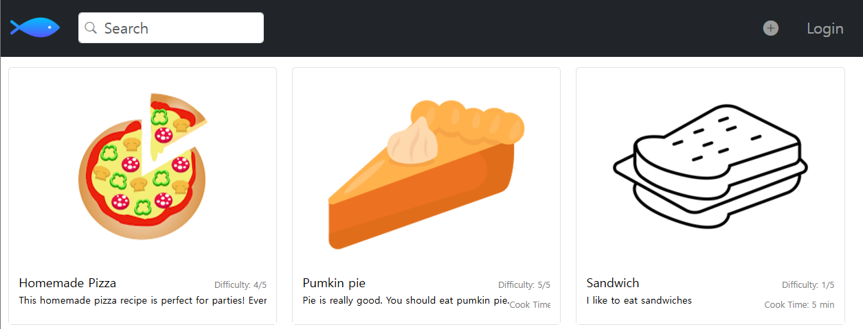
No Login Required Features

Slide 7
Login
Required Features
Viewing profile page
Access
Click the profile icon in navbar
Provides intuitive access for users.
Purpose
Allows users to view and edit liked recipes and cookbooks.
Access liked recipes
Access
Found on the profile page
Provides intuitive access for users.
Purpose
Allows users to store recipes they like

Slide 8
Login
Required Features
Access cookbook
Access
Found on the profile page
Provides intuitive access for users.
Purpose
Allows users to make their own cookbooks with different available recipes
Adding recipes
Access
Plus button on navbar
Provides intuitive access for users.
Purpose
Allows users to add recipes to online

Slide 9
Tools and Methodology
2.
Let’s look into it!!

Slide 10






Let’s look at all the tools!
VCS repository 5/5
We decided to use Github, because we could save our process and also merge commits quickly. Solving merge conflicts are also very easy with github.
Database 5/5
PostgreSQL was used for our project because it’s easily accessible and provides advanced features like queries
IDE 5/5
We decided to use Visual Studio Code because everyone has it in their laptop.
UI tools 4/5
We used HandleBars since that’s what everyone is familiar with due to previous labs and it’s easy to use handling-wise.
Application server 5/5
We used Node JS because this allows developers to run javascript code outside of the browser.
Deployment environment 4/5
Render was used for this project because our class provided clear guidelines for cloud hosting

Slide 11
Let’s look at all the tools!
Testing tool 4/5
Mocha and Chai were used for testing. Thankfully, we could get a lot of help from office hours.
Framework 5/5
We used Express and it really helped us with simplifying our web development

Slide 12
Let’s look at all the methodologies!
Peer review 5/5
Reviewing each other’s code to verify validation helped us build a solid code base in which we rarely had to go back and fix code changes.
Objective alignment 4/5
We always set up some goals for what features had to be done each week. This helped us keep track of how much we had finished as well as tracking future goals.

Slide 13
3.
Diagram
Short Chapter designed for our diagram!!!

Slide 14
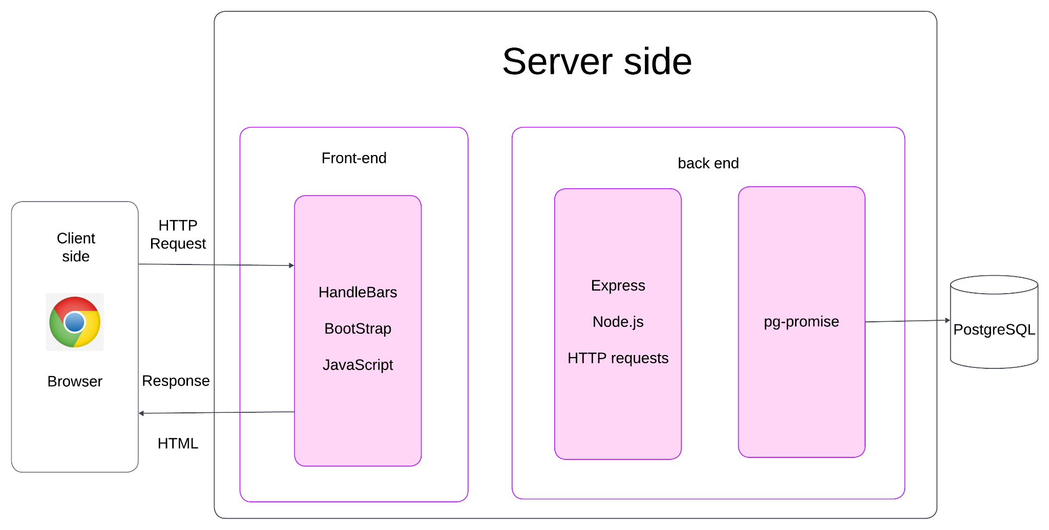
Architecture Diagram
Server Side
Front-end
Handle Bar
CSS
JavaScript
Back-end
Express
Node.js
Http request
pg-promise

Slide 15
4.
Challenges
Let’s look at some Challenges we went through

Slide 16
Challenges
Render failing to connect with Database
A lot of merge conflicts
Javascript Errors
So… how did we overcome these challenges?

Slide 17
Overcoming Challenges
Searching Render Document
Submitting individual branches
Making test cases
Motivating each other to do more work
With these methods, we successfully overcame challenges without affecting our original project plans

Slide 18
5.
Future Scope/Enhancements
Let’s talk about our possible future plans

Slide 19
Future Vision
Short Term
Run design test trials with users
Increase User Base
Share Button
Better UI, responsive
More interaction
Long Term
Admin Accounts
Advertising
Mobile App
Customer service

Slide 20
Technical Enhancement
Rendering pages faster
Delete Account
Linking Email account
These technical enhancements allow users to have a better experience in full.

Slide 21
Customer Support Scope
Email response
Discord server
Receive error reports
Listening to user feedback is very important for improving our app!

Slide 22


Show Case
Time!!!

Slide 23


CREDITS
Yohan,
Special Thanks to
Everyone who watched our slide show!!
Was very fun project guys!
-Yohan-

